Slide 1
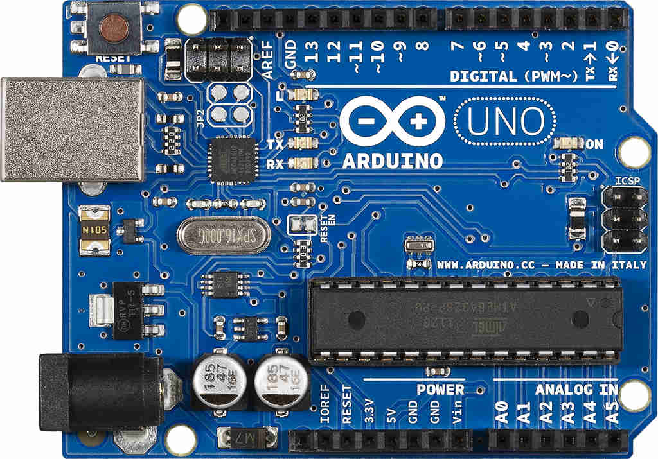
Arduino
THE OPEN-SOURCE ELECTRONICS PROTOTYPING PLATFORM

Slide 2
What is an Arduino ?

Slide 3
The Arduino is an …
single-board microcontroller, intended to make the application of interactive objects or environments more accessible .
◆ Designed to make the process of using electronics multidisciplinary projects more accesible
υ

Slide 4
Arduino can…
Sense the environment by receiving input from variety of sensors.
Affect its surroundings by controlling lights, motors, and other actuators.

Slide 5
Advantages of Aurdino
Open source
Simplified and user-friendly programming language
No additional programmer/burner hardware required for programming board
Portable
Low power consumption

Slide 6
Most popular Arduino Boards
Arduino Uno
Arduino Leonardo
Arduino Mega
Arduino Due
Arduino Micro
Arduino LilyPad
Arduino Yun

Slide 7
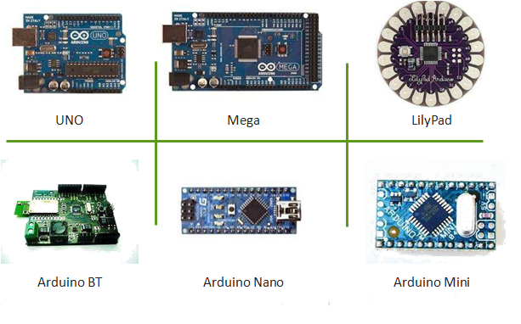
Arduino boards:

Slide 8
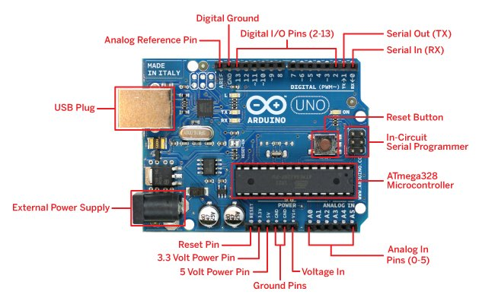
The basic Arduino board
Arduino UNO Board

Slide 9
Features of Arduino UN0
Microcontroller ATmega328 Operating Voltage 5V and 3.3V
Input Voltage (recommended) 7-12V
Input Voltage (limits) 6-20V
Clock Speed 16 MHz
Digital I/O Pins 14 (of which 6 provide PWM output) Analog Input Pins 6

Slide 10
Ingredients” needed
Software/ Development Environment
Hardware
Program sketch
Often patience
.

Slide 11
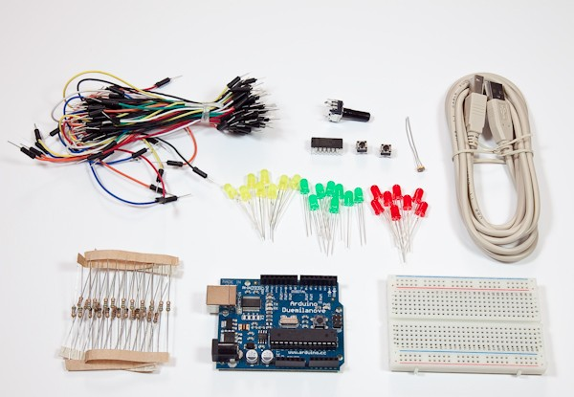
Hard ware Starter Kit

Slide 12
Software IDE Setup
Download and install Arduino (http://www.arduino. cc/en/Main/Software) and Processing (http://processing. org).
Connect the board to the USB port on your computer. Run Arduino IDE.
Set the correct port your device is using
Tools -> Serial Port -> select port beginning with “/dev/cu.usbserial-“
Set the Arduino board type your are using
Tools -> Board -> select correct board type (printed on the chip)

Slide 13


Applications of Arduino
υ
υ
υ
υ
υ
Home Automations Sensor prototyping Robotics
ISP programming
Easy Wifi ,Gsm ,Ethernet , Bluetooth , zigbee Conectivity

Slide 14
Arduino vs other environments
υ
υ
υ
υ
υ
υ
υ
Support for analog input Limited Computing power Comparatively cheap
No GPU unit Limited memory
PWM output available Open source

Slide 15
Where to learn Arduino ?
υ
υ
υ
υ
http://www.arduino.cc/ http://learn.adafruit.com/category/learn-arduino http://playground.arduino.cc/
Recommended books -,Making Things Talk (by Tom Igoe), Getting Started With Arduino (by Massimo Banzi)

Slide 16
Thank you

